Slide 1
«Quota 100» three years after its launch
M. Corsaletti - M. R. Marino - V. Ricci - N. Salerno - G. Santoro - F. Sciarretta - L. Toffoli
A joint INPS-UPB analysis examines how many and which workers have taken advantage of the early retirement programme
16 September 2022 – L’Aquila

Slide 2
What is «Quota100»
Employees and self-employed who, in 2019-2021, reach the combined requirements:
age of at least 62 y and seniority of at least 38 y
Pensioners have to wait additional three/six months before receiving the first instalment (so called «finestre»)
Q100 pensions cannot be combined with working incomes (till the perfection of standard requirements)
Main goal: (re)introduce some, albeit temporary, flexibility in the exit
Notes:
Temporary measure while setting up more structural rules revision -
Safeguard individual preferences -
Promote physiological turnover on the labor market -
Support human capital renovation and productivity -
The argument of safeguarding individual preferences is commonly recognized, while that of the effects on the labor market and productivity are less obvious and more debated –
This channel can also be seen as experimental, in the sense that it can give information on the actual urgency of anticipating the exit from work and how it varies depending on the characteristics of the workers

Slide 3
Contents
Descriptive statistics based on INPS monitoring
Monitoring vs. TR of DL 4/2019
Logit analysis of the determinants of the decision to retire using the Q100
Notes:
On the part of the Institutions, the need was felt to clarify both the number of applications and the related expenditure to answer continuous questions and doubts arisen in the public debate since the very first moment Quota 100 became available.

Slide 4
Data from INPS monitoring
380,000 applications accepted
as of 31 December 2021
Women
31%
Men
69%
Private employees
49%
Public employees
31%
Self-employed
20%
Total projected adhesions
≈ 450,000

Slide 5
Data from INPS monitoring
Age and seniority at the first payment (effective date)
The joint distribution by age and seniority at the effective date shows that approximately 63 percent of beneficiaries made use of Q100 with at least one of the two requirements equal to the minimum threshold (62 years of age or 38 years of seniority).
Average age = 63,1 y
Average seniority = 39,6 y

Slide 6
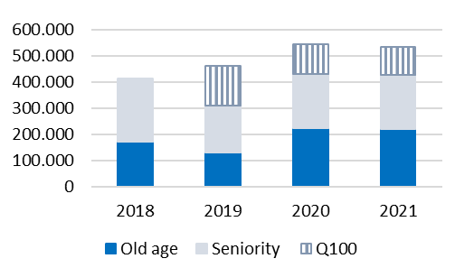
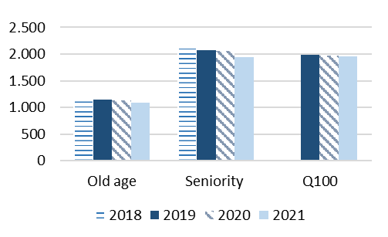
Data from INPS monitoring
New pensions by category and effective date
Gross monthly amounts,
by category and effective date
Notes:
Reduction of old-age and seniority pensions between 2018 and 2019 is due to:
1) the 5-months increase of old-age requirement
2) the (re)introduction of a 3-months lag before the first installment for seniority pensions
3) the overlapping of Q100 with standard retirement channels
In the first year, Q100 replaces old-age and, to a lesser extent, seniority retirement. In the second and third years, Q100 adds on top the other two retirement channels

Slide 7
Comparison of take-up rates
For those meeting eligibility requirements in 2019
Take-up rates are: 39% in 2019, 14% in 2020 and 4% in 2021, for an overall value of 49% in the three years
Notes:
INPS monitoring has information only about the Fund that pays the pension. For this reason, it is not possible to disentangle the group of «inactive but not retired» from the group of «active». To make this distinction possible, we constructed another enlarged dataset using fiscal identification numbers to match INPS monitoring with working and contributory histories

Slide 8

Monitoring vs. Technical Report
Take-up less than forecast
(374,000 vs. 678,000, with effective date in 2019-2021)
Pension benefits in line with forecasts
Duration of benefits greater than expected
In the TR, the take-up rate is not broken down by duration of maximum possible anticipation, while actual data show a take-up rate of 4 per cent for people who can anticipate at most by 1 month, rising steadily to a peak of 74 per cent for people who can anticipate at most by 20-25 months
Actual data show the propensity to use 90% of the maximum possible anticipation
In 2019-2021, expenditure was €12.3 billion (including application backlog), €1,7 billion less than the estimates presented in the TR as corrected with the 2019 Update and the 2020 Budget Act (€14 billion compared with)
Over the longer period 2019-2025, expenditure projected based on monitoring amounts to €23.2 billion, €5.8 billion less than the estimates

Slide 9
Econometric analysis - Logit
Which variables had the greatest impact on take-up of the pension programme?
Pool: Sample of people who became eligible for Q100 in 2019 (about 37,000 individuals) enriched with information from INPS monitoring on Q100 (using fiscal identification numbers)
Individual characteristics: gender, age and contributory history at the earliest moment of eligibility for Q100, region of residence, employment status, pension fund, last annual working income, decision on opting for Q100 in 2019-2021

Slide 10
Findings: marginal probabilities
Regressors:
gender, seniority, activity status, pension fund, decile of income, decile of anticipation, interaction gender/pension fund, interaction income deciles/seniority
To understand which variables most impact take-up for Q100, we need to look at marginal probabilities:
How does the probability of opting for Q100 change as specific variables change

Slide 11
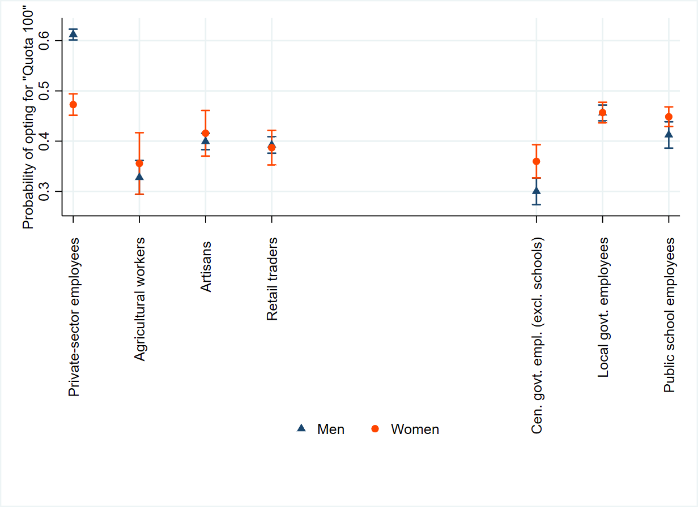
Probabilities by segment and gender
Highest probabilities: private-sector employees
Lowest probabilities: Central Government employees and agricultural workers
Only male private-sector employees (the largest category) are more likely to retire than women; in the other categories the probabilities of retirement are similar, with women being slightly more likely to retire
Notes:
Jobs in the private-sector are on average heavier than in the public -
The Local govt. group includes employed in the Health care system in which responsibilities and tasks are often comparable or even heavier than the average private -
Also employed in the Educational system show probabilities less distant from the private group, and this can be explained by the difficulties of frontal teaching and dealing with the youngsters -
Apparently, gender differences in tasks and responsibilities are much more widespread withing private employees then elsewhere
Low probabilities for self-employed can be explained also in the light of lower contribution rates compared to employees (24 vs. 33%) that bring to lower future pensions with a stronger negative income-effect on the incentive to adhere to Q100 -
They cannot afford shorter careers that would bring to even lower pensione

Slide 12
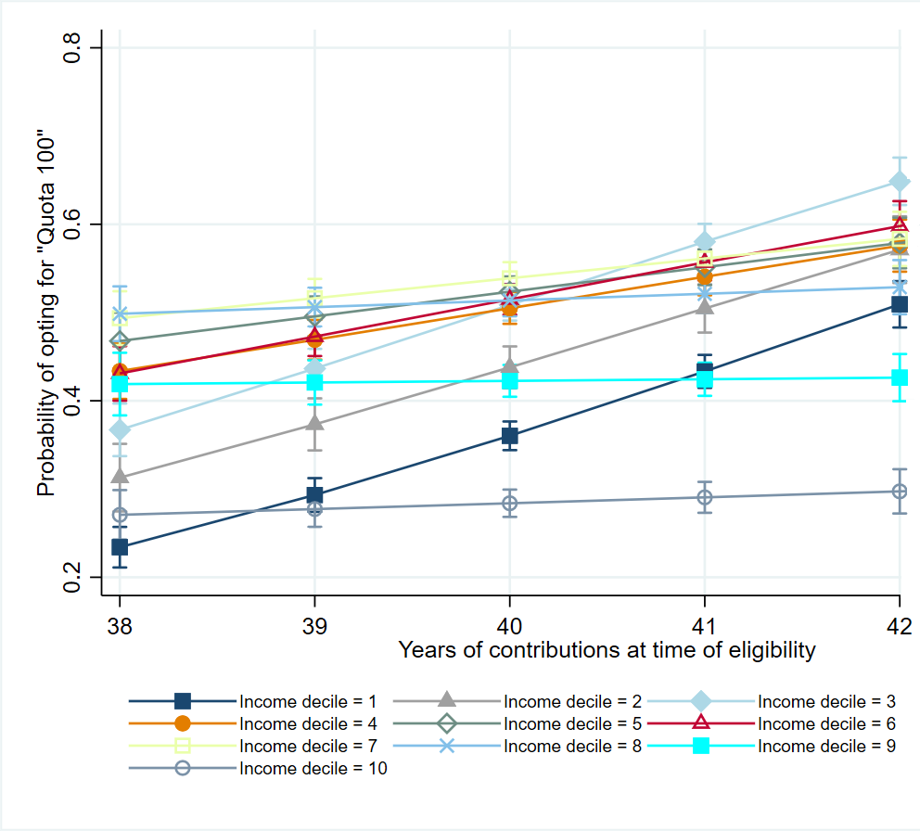
Probabilities by income decile and contributory history
The probability increases as the number of years of contributions increases (effect attributable to short careers impacting benefits) …
… except for high-income workers (less concerned about the amount of benefits)
Notes:
The probability to adhere to Q100 is growing with the level of seniority -
This is particularly evident for low income groups (steepness) and less evident or even negligeable for the highest income groups (flatness) -
The reason can be traced back to an income-effect -
Low income workers will already receive low pensions and are relatively more inclined to postpone the choice of Q100 in order to mature more adequate levels of pension –
For earners of high incomes this income-effect is less relevant -
High incomes are also normally correlated with high accumulated assets that make the variation of pensions due to early exits less relevant for individual/family budgets

Slide 13
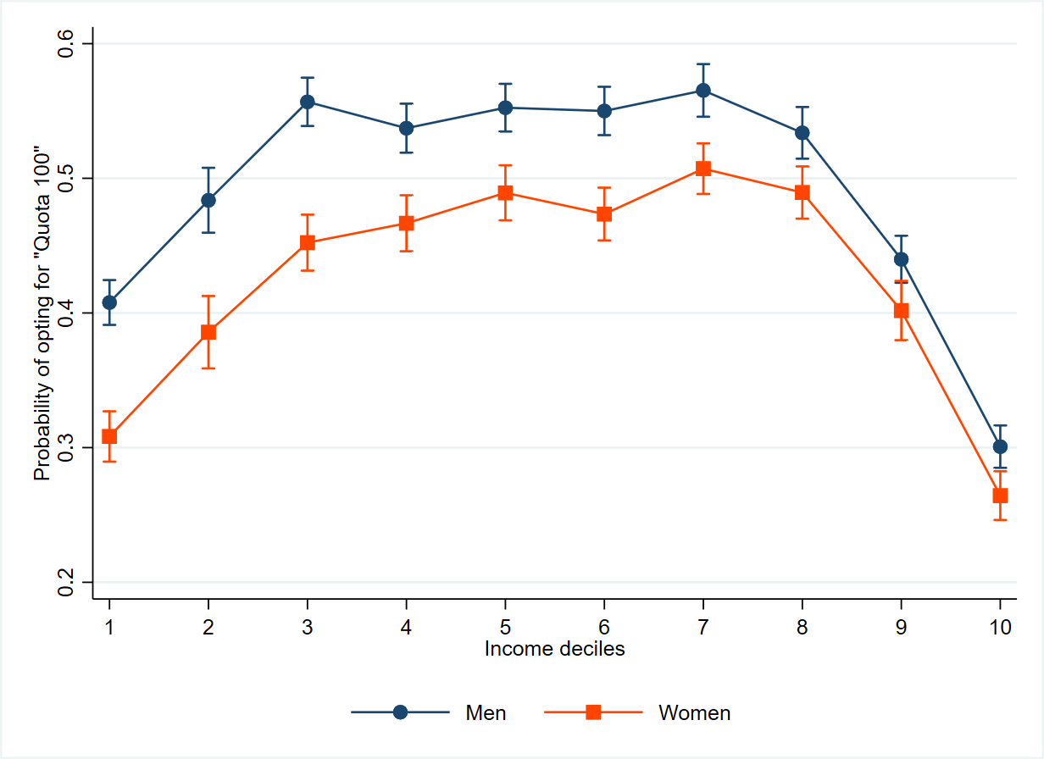
Probabilities by income decile and gender
The probability curve is hump-shaped: it rises until the third decile, levels off and then declines for the last two deciles, falling below that for the first decile:
Growing incomes generate higher pensions and high pensions make early exit more affordable
Highest incomes are associated with gratifying and better paying jobs that encourage postponing retirement

Slide 14
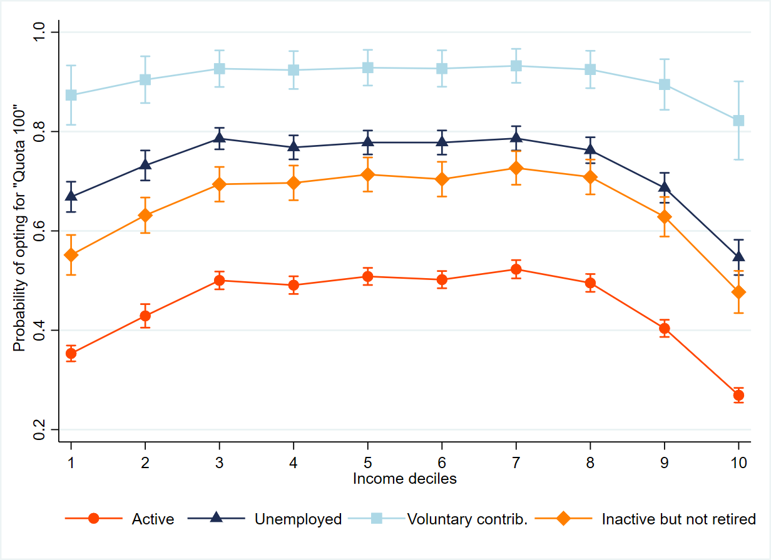
Probabilities by income decile and employment status
Compared with the active population, voluntary contributors, the unemployed and the inactive but not retired are more likely to retire with Q100
→ possibility of acquiring an income

Slide 15
Annex if there are some seconds left
Some conclusions
Retirees with Q100 numerous albeit less than forecast
Expenditure less than forecast but by a smaller percentage than for retirees (duration of benefits compensates)
However, it was the first time a Technical Report tried to adopt take-up rates different from 100%
Estimated probabilities can help future design of flexible retirement (net of special circumstances in which Q100 was introduced and stayed available)

Slide 16
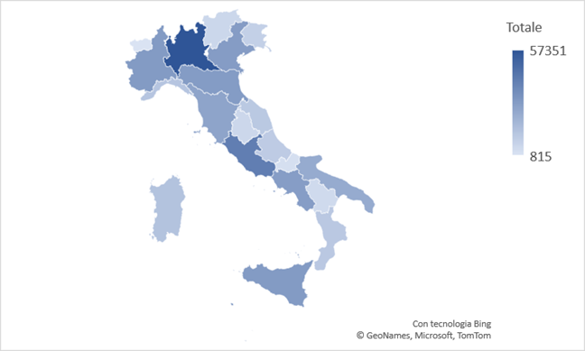
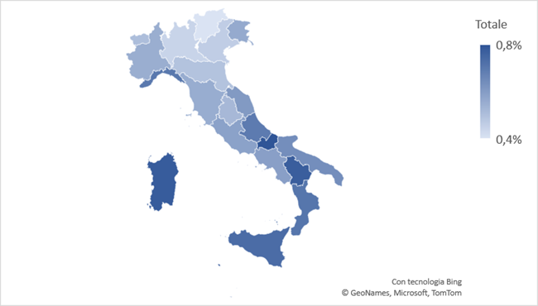
Data from INPS monitoring
Geographical distribution at regional level
Number of retirees with Q100
% of employed
In 2019-2021, retirees with Q100 are more numerous in the North. Expressed as percent of the employed, the incidence is on the contrary larger in the South. However, take-up rates are substantially homogeneous across territories. As regressor in a Logit model, the Region of residence reveals not statistically significant when used in combination with other characteristics.
Notes:
Possible implications for short-term dynamics of labor force, especially in some sectors like Health Care and Education

Slide 17
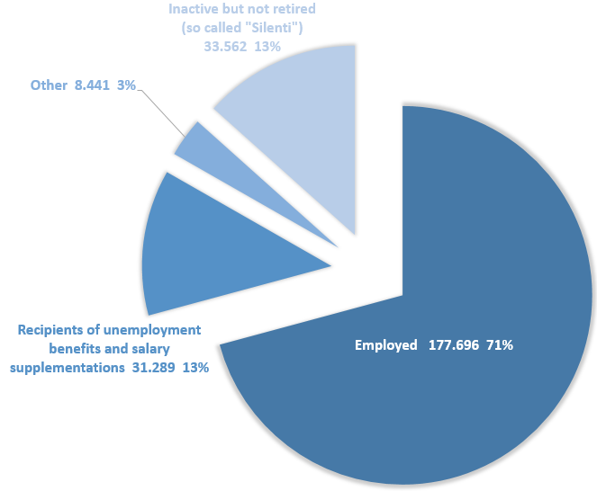
Data from INPS monitoring
Retirees in the private sector with Q100 by last occupational status
Including public employees, the employed count for 81%, recipients of unemployment benefits and salary supplementations count 8%, the inactive not retired count 9%, and the rest 2%.

Slide 18
Take-up rates
For those meeting eligibility requirements in 2019
Notes:
INPS monitoring has information only about the Fund that pays the pension. For this reason, it is not possible to disentangle the group of «inactive but not retired» from the group of «active». To make this distinction possible, we constructed another enlarged dataset using fiscal identification numbers to match INPS monitoring with working and contributory histories

Slide 19
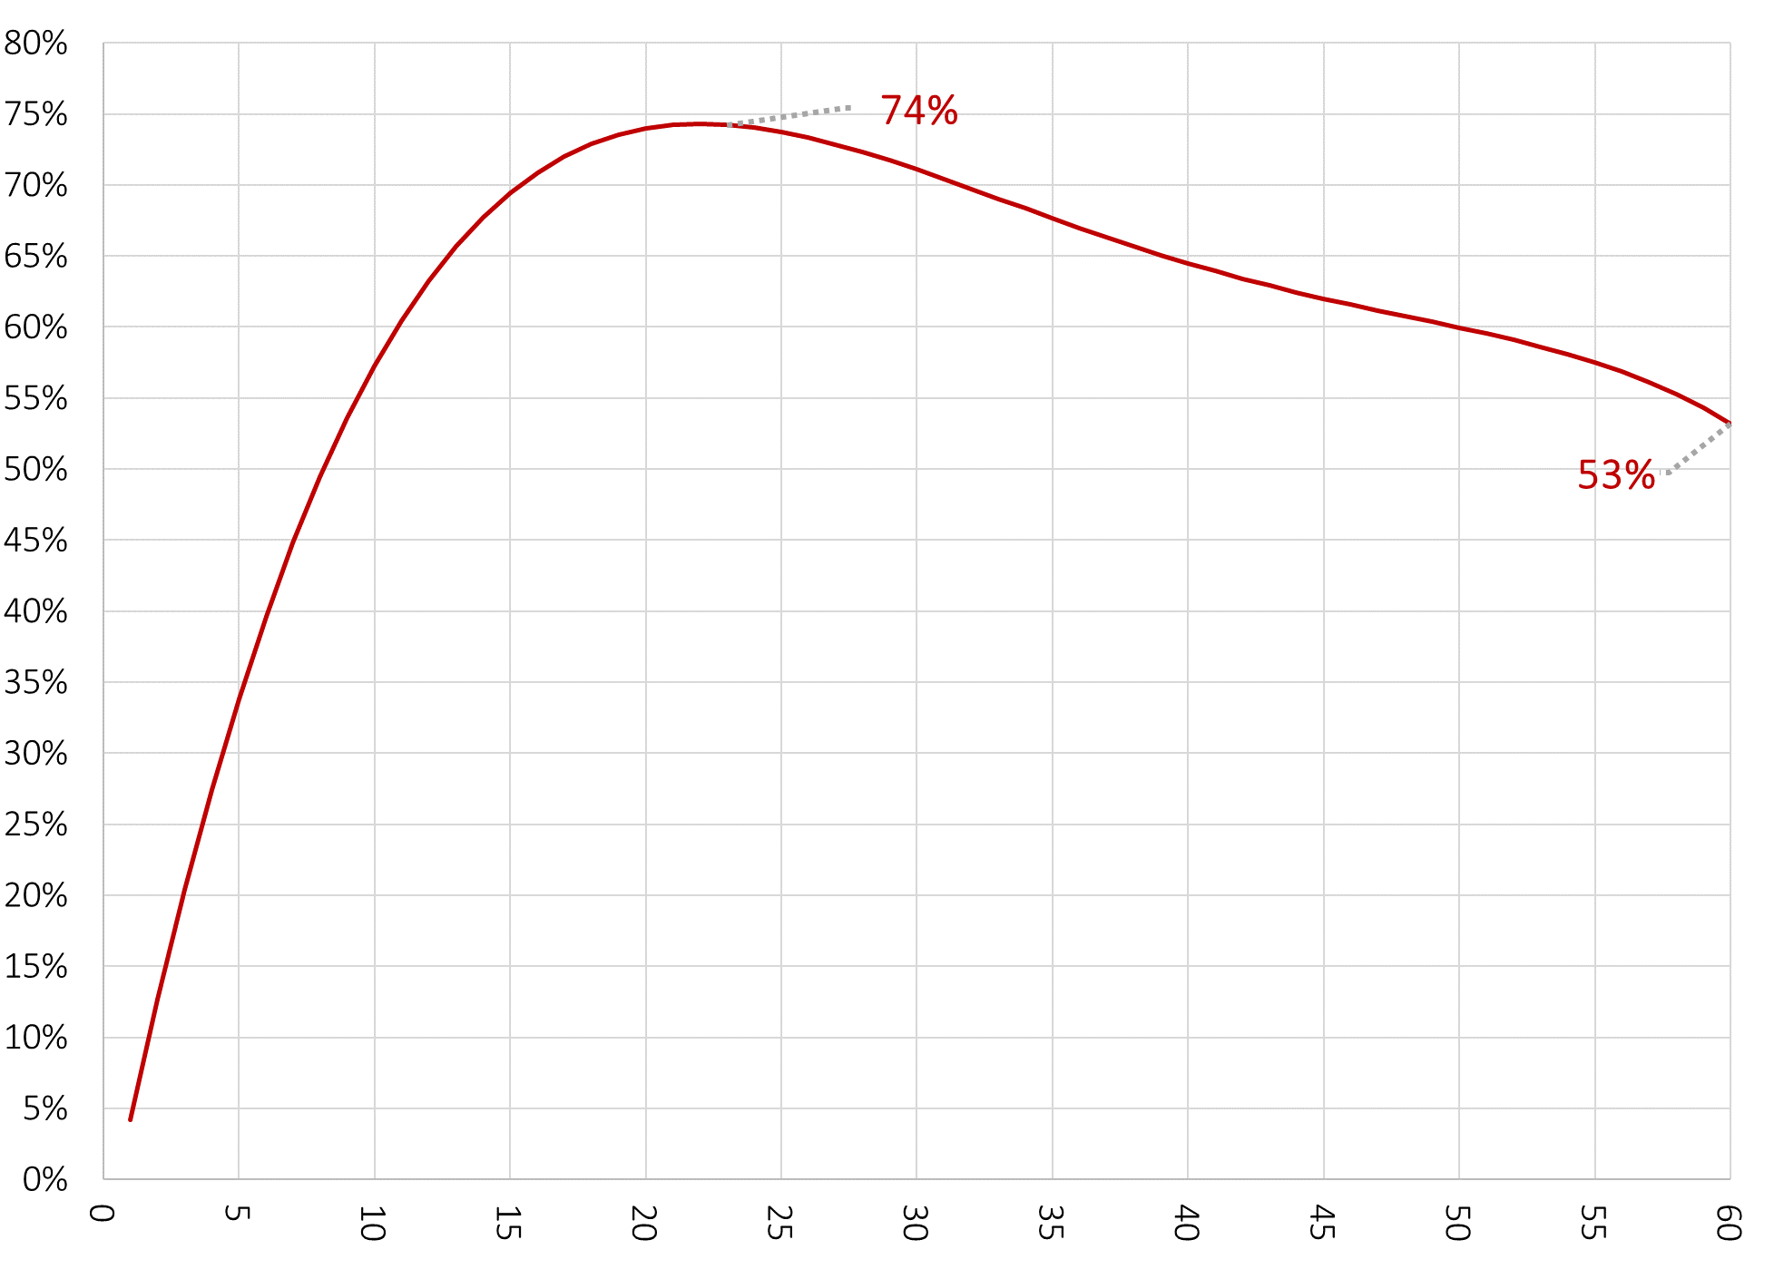
Data from INPS monitoring
Take-up rates per maximum number of months of anticipation
Take-up rates
Maximum available anticipation
Notes:
Take-up rate = [number of workers who use Q100]/ [number of workers who can use it]
Take-up rates grow together with the maximum number of months of anticipation. Indeed, for low anticipations it is easier to wait until standard requirements. Take-up rates reach the highest values for mid anticipations. The declining path after 20-25 m of anticipation could depend on the fact that workers with longer possibilities of anticipation to adhere have still time to make their choice.

Slide 20
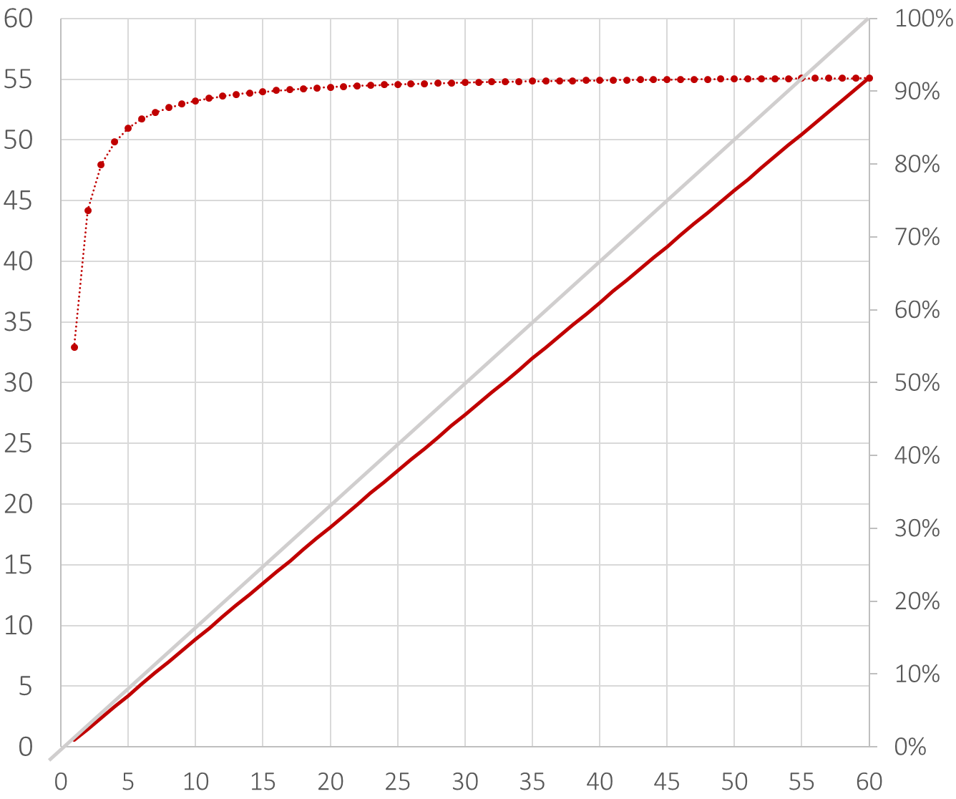
Data from INPS monitoring
% of usage of anticipation per maximum number of months of anticipation
% of usage of maximum anticipation
Effective anticipation
Maximum available anticipation
Notes:
By the end of 2021, who retired with Q100 used on average 90% of total potential anticipation. Only for maximum anticipations below 10 months the percentages are lower but ever above 55%,

Slide 21
Expenditure at 31 December 2021 and projected to 2025
The projection includes the application backlog and prudentially uses the growth rates set out in the TR (they take account of the continuation of the accumulated stock of Q100 pensions, their gradual transformation into ordinary old-age or early retirement pensions, the lower value of the latter as a result of opting for Q100 and new Q100 pensions)
Two major considerations:
The take-up rate assumptions in the TR are appropriately conservative (there were no precedents)
We cannot rule out a priori the possibility that in coming years the take-up rates could be higher than those seen so far (both those for the first year of eligibility and those deferred for one or more years)

